Slide 1
Multimodal Personality Recognition System for Interviews

Slide 2
Background
In today's highly competitive job market, accurately assessing the personality traits of job candidates has become increasingly important for companies. Personality traits can significantly influence an individual's job performance, team collaboration, and overall fit within the company culture. Therefore, many companies are actively seeking effective methods to evaluate the personality traits of job candidates during the interview process. The widespread use of personality tests is a notable trend in this regard. Approximately 80% of Fortune 500 companies use personality tests to screen candidates for senior positions. Furthermore, 32% of HR departments use personality tests to screen executives, and 28% use them for middle management. Companies such as General Motors, Procter & Gamble, and McKinsey use the MBTI (Myers-Briggs Type Indicator) to manage their employees.
[1]卓安妮.MBTI职业性格测试在职场上的应用[J].知识经济,2009(2):5-5 https://qikan.cqvip.com/Qikan/Article/Detail?id=29256126
Notes:
在当今竞争激烈的就业市场中，准确评估求职者的性格特征对企业来说越来越重要。性格特征可以显著影响个人的工作表现、团队协作以及与公司文化的整体契合度。因此，许多公司正在积极寻求在面试过程中评估求职者性格特征的有效方法。

Slide 3
Movitation
Manual Methods (e.g., Questionnaires, Expert Assessments):
**High Subjectivity:** Rely on the self-reports of respondents or the subjective judgments of experts, which are easily influenced by social desirability bias (respondents deliberately aligning with the “correct answers”) or evaluator biases.
**Low Efficiency:** Designing questionnaires, collecting data, and conducting manual analysis are time-consuming and labor-intensive, making it difficult to scale up.
**Static Nature:** Questionnaire items are fixed and cannot dynamically adapt to individual differences in language expression or complex situations.
**Cultural Limitations:** Many personality tests (e.g., MBTI) are designed based on specific cultural contexts and lack sufficient cross-cultural universality.
Traditional Pure Text-Based Automated Systems:
**Shallow Analysis:** Depend on keyword matching, word frequency statistics, or simple machine learning models (e.g., logistic regression), which are unable to understand context, metaphors, or emotional tendencies.
**Poor Flexibility:** Rule-based systems struggle to cover complex linguistic phenomena (e.g., irony, double negatives) and require manual maintenance of rule libraries.
**Strong Data Dependency:** Require large amounts of labeled data for model training, which is costly to annotate and limits the model's generalization ability.
**Inability to Capture Dynamics:** Unable to dynamically adjust judgments through dialogue or interaction; they can only process static text.
[1]https://leaders.com/articles/business/personality-tests/
[2]https://personalitylist.com/profile/25785/significant-businesses/mckinsey-and-company/
Notes:
企业在招聘，尤其是中高层职位时，越来越重视准确评估求职者性格，以了解其个性、行为风格和潜力，预测工作表现。研究表明，80% 的财富 500 强公司用性格测试筛选高层候选人，32% 的 HR 用其筛选高管，28% 用于中层管理，显示企业急需准确性格评估工具。
准确性格评估能帮企业快速筛选合适候选人，减少招聘时间和成本，提高招聘质量，降低离职率和招聘失误率。如某公司用 MBTI 测试后，员工效能提高 98%，节省 2000 万美元，凸显准确性格评估对招聘的重要价值。

Slide 4
Problem
Social Desirability Bias In Research
Social desirability bias leads participants to provide inaccurate responses.
This affects the validity and reliability of research results.
It is difficult to accurately measure true feelings during testing, leading to significant differences in retest results.
In corporate recruitment, many people are aware of the "tricks" to pass these tests, resulting in unreliable test outcomes.
How can we accurately and quantitatively measure a person's personality without various biases?
Single - Modality May Miss Important Information
Single - modality assessments lack comprehensiveness and may miss important information.
A text - based assessment may overlook the candidate's voice tone and facial expressions, while an audio - based assessment may miss the candidate's body language and text content.
Notes:
传统的性格探究方法容易受到各种偏见的影响，包括社会期望偏见，应聘者可能会提供他们认为对面试官更有利的答案，而不是真正反映他们自己的性格特征。 另一方面，单模态评估缺乏全面性，可能会错过重要信息。例如，基于文本的评估可能会忽略候选人的语调和面部表情，而基于音频的评估可能会错过候选人的肢体语言和文本内容。

Slide 5
Existing Methods
Questionnaire Method
In traditional personality assessment methods, filling out questionnaires is one of the most common ways. Job candidates need to answer a series of questions based on their own situations, such as the MBTI questionnaire and the Big Five Personality questionnaire. These questionnaires assess candidates' personality traits through standardized questions and scoring systems. However, this method is susceptible to social desirability bias, where candidates may provide insincere answers to impress interviewers. For example, studies have shown that many candidates exaggerate their strengths and conceal their weaknesses in self-report questionnaires, leading to inaccurate assessment results.
Interviewer's Subjective Judgment
During the interview process, interviewers make subjective judgments about candidates' personalities based on their observations and experience. Interviewers pay attention to candidates' language expression, behavior, facial expressions, and other aspects to form an impression of their personalities. However, such subjective judgment is easily influenced by the interviewers' personal biases and subjective factors, lacking objectivity and reliability. For example, interviewers may have prejudices against candidates due to stereotypes about certain personality types, affecting recruitment decisions.
Notes:
在讲解我们的方法前，让我们先看一下现存的方法是如何衡量一个人的性格的。 1.传统性格评估方法中，填写问卷是最常见的方式之一。求职者需要根据自己的情况回答一系列问题，如 MBTI 问卷、大五人格问卷等。这些问卷通过标准化的问题和评分体系来评估求职者的性格特征。然而，这种方法容易受到社会期望偏差的影响，求职者可能会为了给面试官留下好印象而提供不真实的答案。例如，研究表明，许多求职者在自我报告问卷中会夸大自己的优点，隐瞒自己的缺点，导致评估结果不准确。
2.在面试过程中，面试官会根据自己的观察和经验对求职者的性格进行主观判断。面试官会关注求职者的语言表达、行为举止、面部表情等方面，从而形成对求职者性格的印象。然而，这种主观判断容易受到面试官的个人偏见和主观因素的影响，缺乏客观性和可靠性。例如，面试官可能会因为对某种性格的刻板印象而对求职者产生偏见，影响招聘决策。

Slide 6
Existing Methods
Monomodal Personality Recognition(NiuKe AI-NowGPT Model)
Innovations: Based on the semantic analysis module of the self-developed large language model, it achieves:
- Negative Speech Detection: Identifying the frequency distribution of negative words (such as "impossible," "difficult").
- Cliché Recognition: Detecting templated responses through TF-IDF weighting.
- Cognitive Complexity Assessment: Analyzing the depth of the tree-like structure of argument logic.
Deployment Effect: In IT job screening, the text analysis module alone contributes 42% of the explanatory power for job match prediction.

Slide 7
Compare With Existing Methods
Limitations of Traditional Methods
Social Desirability Bias: Candidates may provide insincere answers to impress interviewers, resulting in inaccurate assessment results.
Subjectivity: Interviewers' subjective judgments are easily influenced by personal biases and subjective factors, lacking objectivity and reliability.
Lack of Comprehensiveness: Traditional methods usually focus on only one type of modality data, such as text of questionnaire, and fail to capture candidates' personality traits comprehensively.
Low Efficiency: Filling out questionnaires and interviewers' subjective judgments are time-consuming and labor-intensive, making them inefficient and unable to meet the needs of large-scale recruitment by enterprises.
Our Advantages
In contrast, our multimodal approach can overcome the limitations of traditional methods.
By integrating data from multiple modalities, such as speech, text, and images in videos, our method can more comprehensively and accurately capture candidates' personality traits, enhancing the accuracy and reliability of assessments.
Moreover, our method can also reduce the impact of social desirability bias, increasing the objectivity and fairness of the assessment.
Notes:
传统性格评估方法存在以下缺点： 求职者可能会为了给面试官留下好印象而提供不真实的答案，导致评估结果不准确。 面试官的主观判断容易受到个人偏见和主观因素的影响，缺乏客观性和可靠性。 传统方法通常只关注某一种模态的数据，如语言表达或行为举止，无法全面捕捉求职者的性格特征。 填写问卷和面试官主观判断耗时费力，效率低下，难以满足企业大规模招聘的需求。 * **我们的优势** ：相比之下，我们的多模态方法可以克服传统方法的这些缺点。通过整合多种模态的数据，如视频中的语音、文本、图像等，我们的方法可以更全面、准确地捕捉求职者的性格特征，提高评估的准确性和可靠性。并且我们的方法可以减少社会期望偏差的影响，提高评估的客观性和公正性。

Slide 8
Our Methods
By conducting a comprehensive analysis of the interviewee's language expression, vocal characteristics, facial expressions, and body movements, we construct a multi-dimensional personality assessment model.
The system adopts a four-stage analysis process of "video deconstruction - feature extraction - multimodal fusion - personality profiling," breaking through the limitations of traditional single-dimensional assessment to achieve more accurate identification of personality traits.
Notes:
通过对面试者的语言表达、语音特征、面部表情及肢体动作进行全方位分析，构建多维度的性格评估模型。系统采用"视频解构-特征提取-多模态融合-性格概述"的四阶段分析流程，突破传统单一维度测评的局限，实现更精准的人格特质识别。

Slide 9
System Design
Model Integration: Integrate the Tongyi Qianwen VL-MAX-LATEST model from Alibaba Baileian, which can handle audio and videos for chatting.
Video Chat: Users chat with AI via video. AI collects voice, text, and images in real-time.
Video Processing: Extract speech and action behavior features from the video after chatting
Personality Inference: Leverage LLM to Analyze Speech and Action Features for Personality Insights.
Analysis Summary: Post-interview, conduct a comprehensive analysis of the chat video and generate a final personality report.
Notes:
我们将接入阿里百炼平台的通义千问VL-MAX-LATEST模型，该模型具备强大的多模态处理能力，能够直接处理图片、视频等数据进行聊天。 通过上述模型，用户可以与AI进行视频聊天。在聊天过程中，AI会实时收集和处理用户的语音、文字、图像等多模态数据。 在聊天结束后，我们对聊天产生的视频流进行初步处理，提取包括但不限于声音,动作行为特征数据。 人格推断：利用LLM分析言语和行为特征以获得人格洞察力 在面试结束后，再次运用多模态性格识别方法对整个聊天视频进行全面、系统地分析，结合聊天过程中的动态分析结果，生成最终的性格评估报告。 Personality Analysis: Analyze extracted features using multimodal methods to determine personality traits, updating results dynamically. 利用多模态性格识别方法，对提取到的特征数据进行综合分析，判断用户的性格特征，并在聊天过程中动态更新分析结果。

Slide 10

Model Integration
Qwen-VL-Max is essentially a "visual-language large model." Building on the linguistic capabilities of the general Qwen-LM, it integrates a visual encoding module (Vision Transformer + Adapter), enabling the model to fuse and process various input forms such as images, text, and bounding boxes.
https://github.com/QwenLM/Qwen-VL/blob/master/README_CN.md
Simplified schematic flowchart
Input multiple high-resolution images and text
High-Resolution Preprocessing & Tiling
Cross-Attention Adapter
(VL Adapter)
Vision Encoder (ViT-giant / bigG …)
LLM Decoder (Qwen-7B+ …)
Output text or multi-turn dialogue responses.
Notes:
Qwen-VL-Max 本质上是一个“视觉-语言大模型”，在通用 Qwen-LM 的语言能力基础上，接入了视觉编码模块（Vision Transformer + Adapter），使得模型能将图像、文本、检测框等多种输入形式进行融合处理。

Slide 11
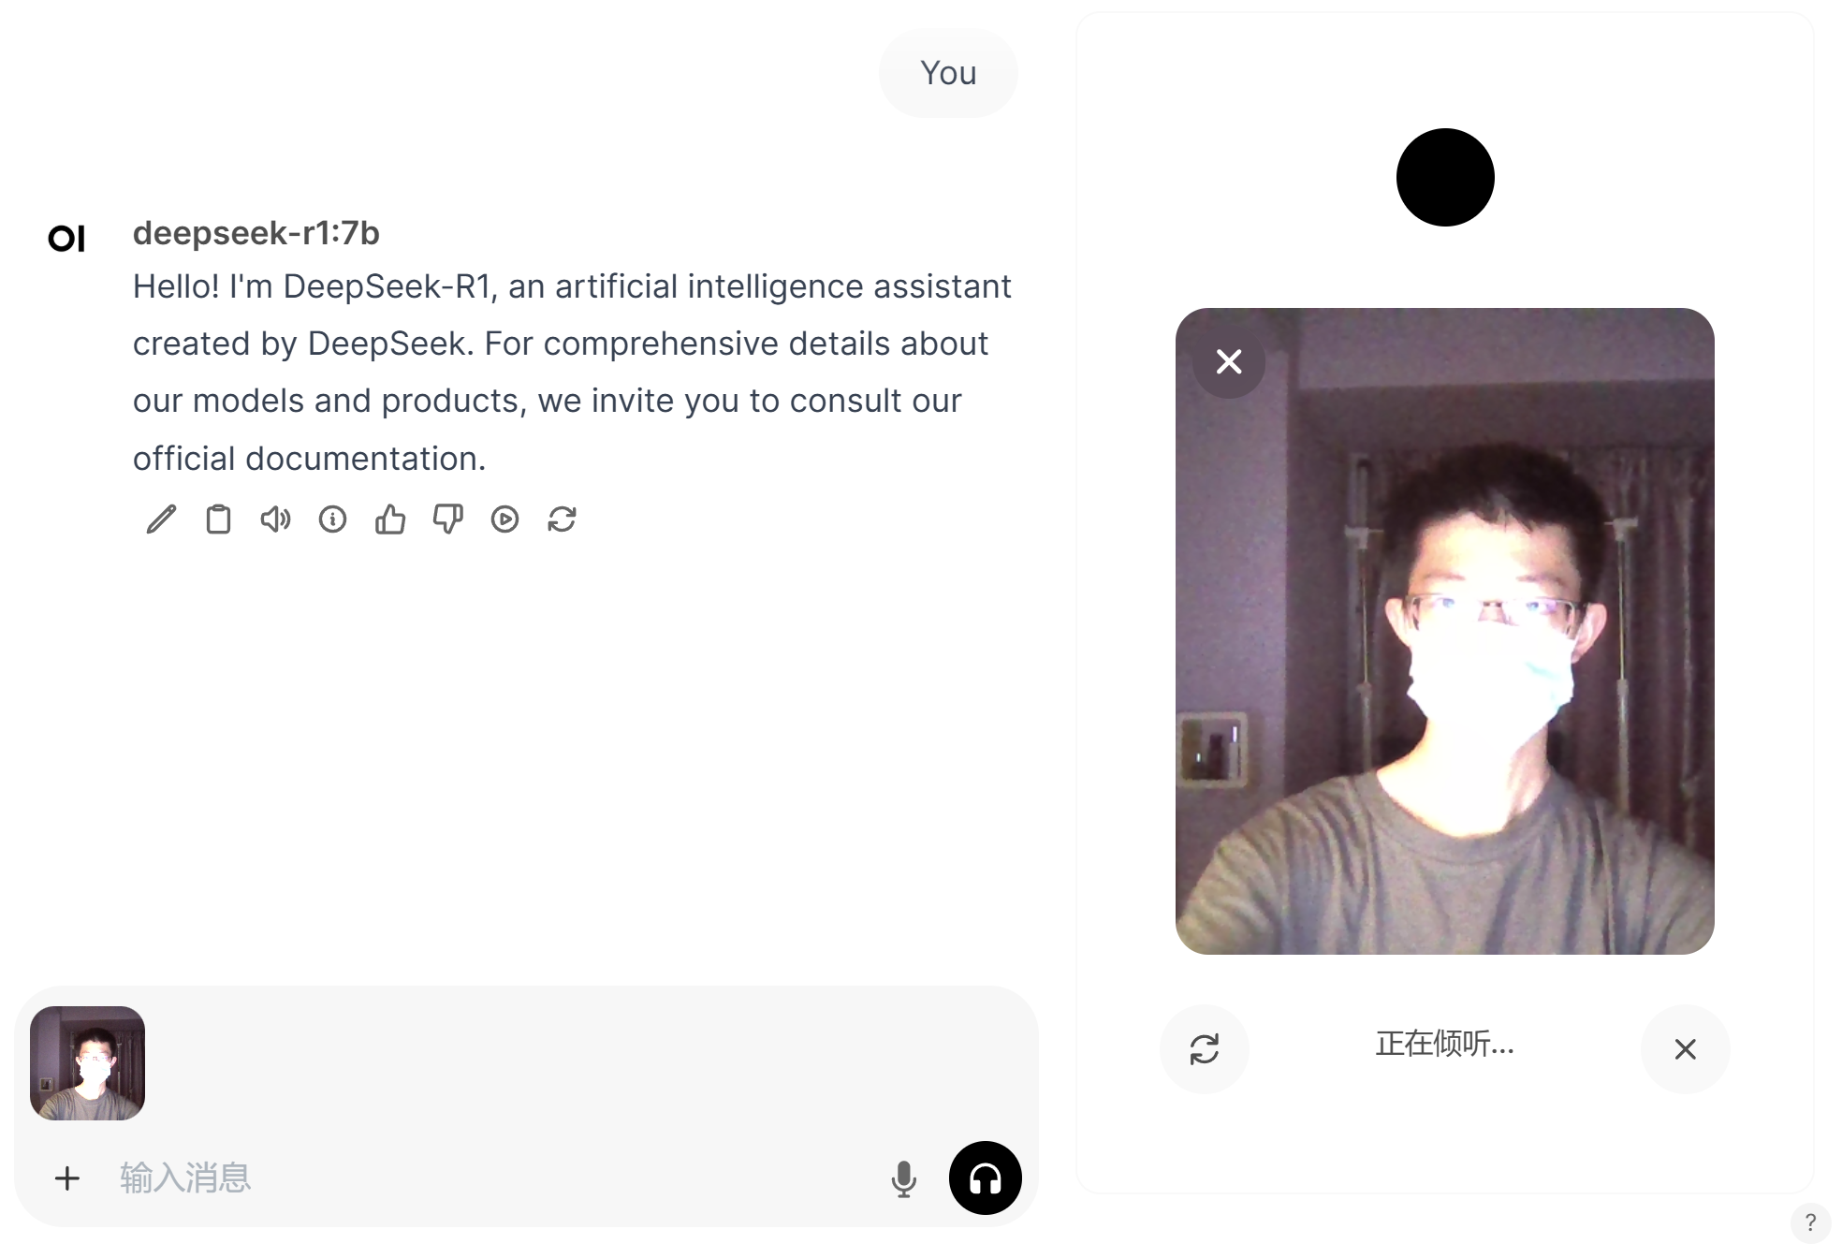
Video Chat
Actually, this is the interface of Open Web UI, and we will create our interface based on this interface.
Ultimately, we may remove the input box in the bottom left corner and allow the left area to fully display the interaction process. And in the middle directly above, make a prominent end button.
https://docs.openwebui.com/getting-started/advanced-topics/development
Notes:
实际上，这是open-webui的界面，我们将仿照这个界面做出我们的界面。 最终，我们可能会取消左下角的输入框，让其左边的区域完整显示交互过程。并且在正上方的中间，做一个醒目的结束按键。

Slide 12
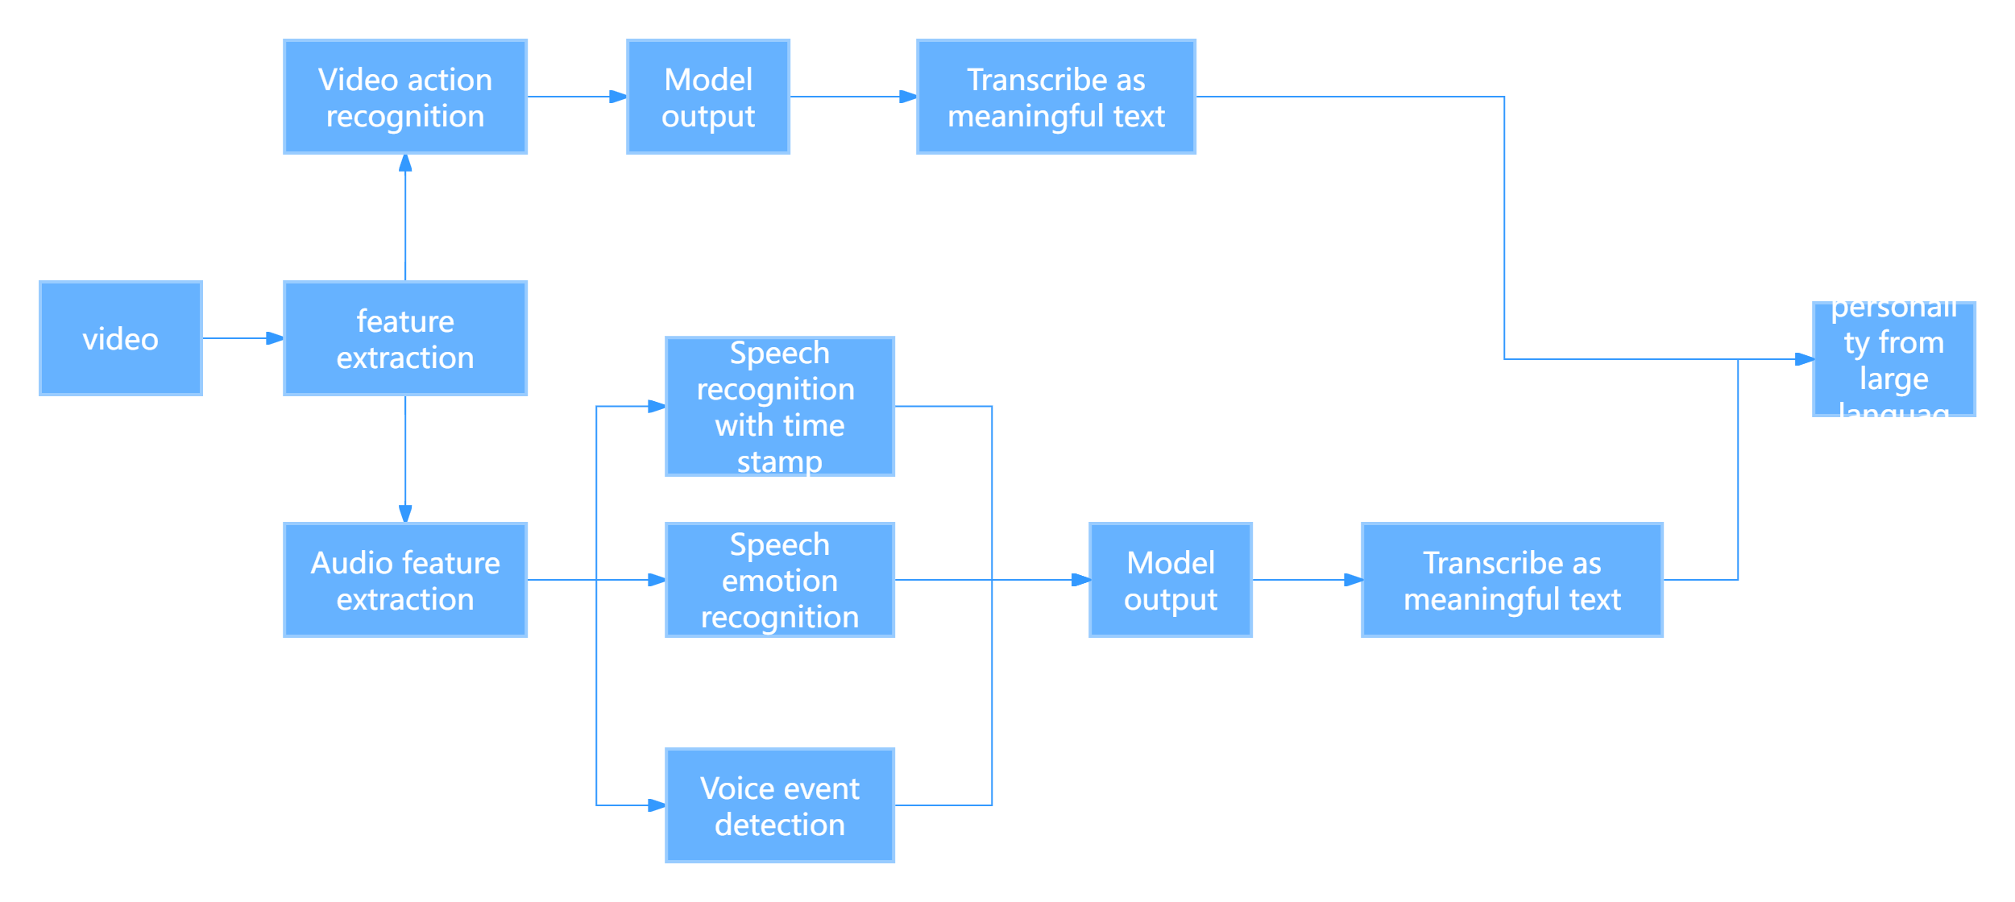

Video Processing
LLM

Slide 13
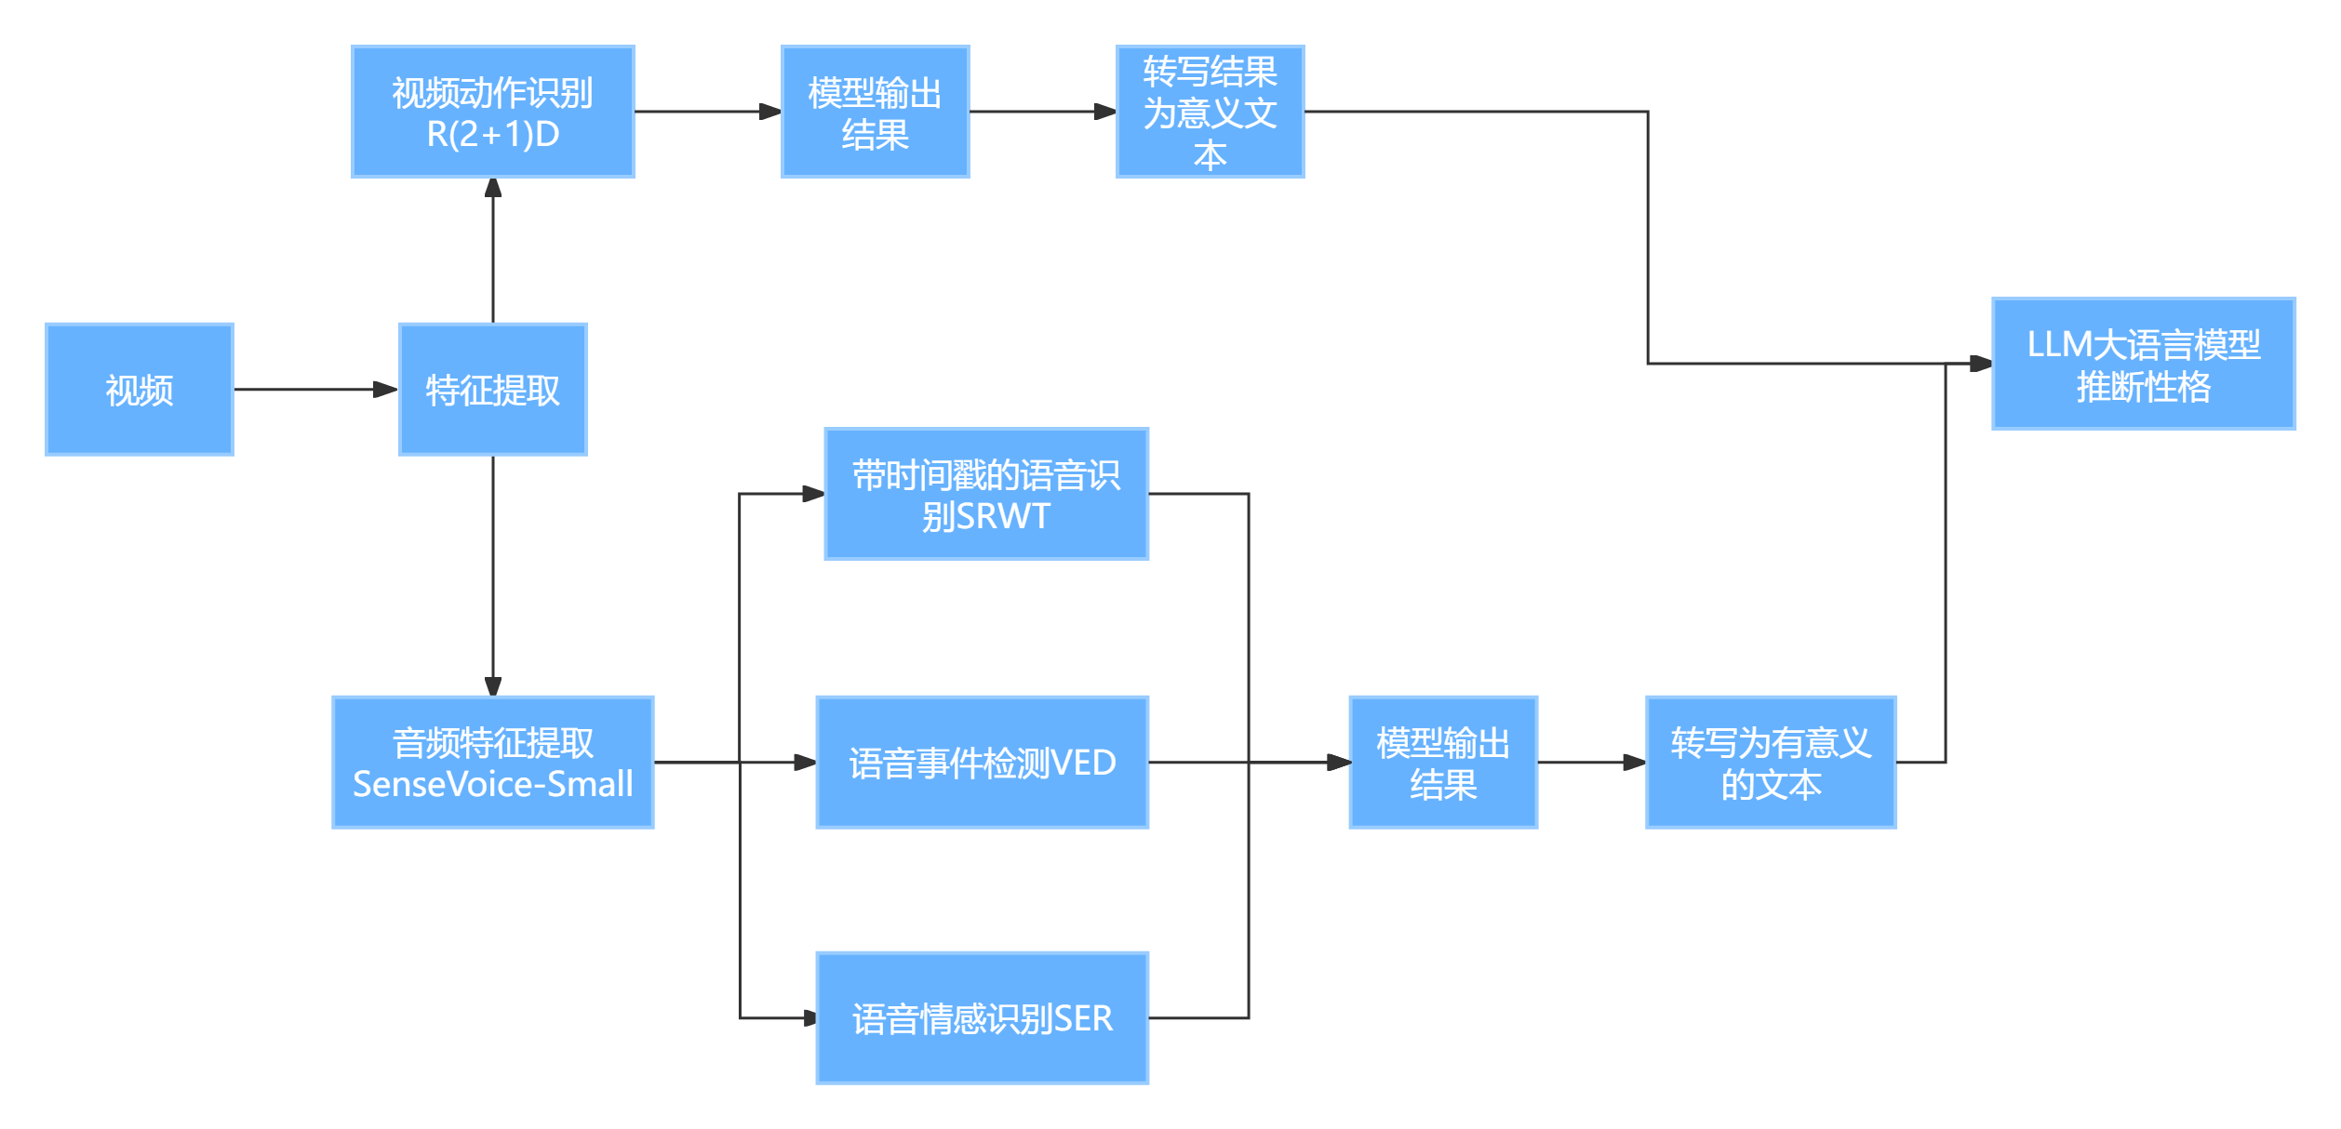
Video Processing

Slide 14
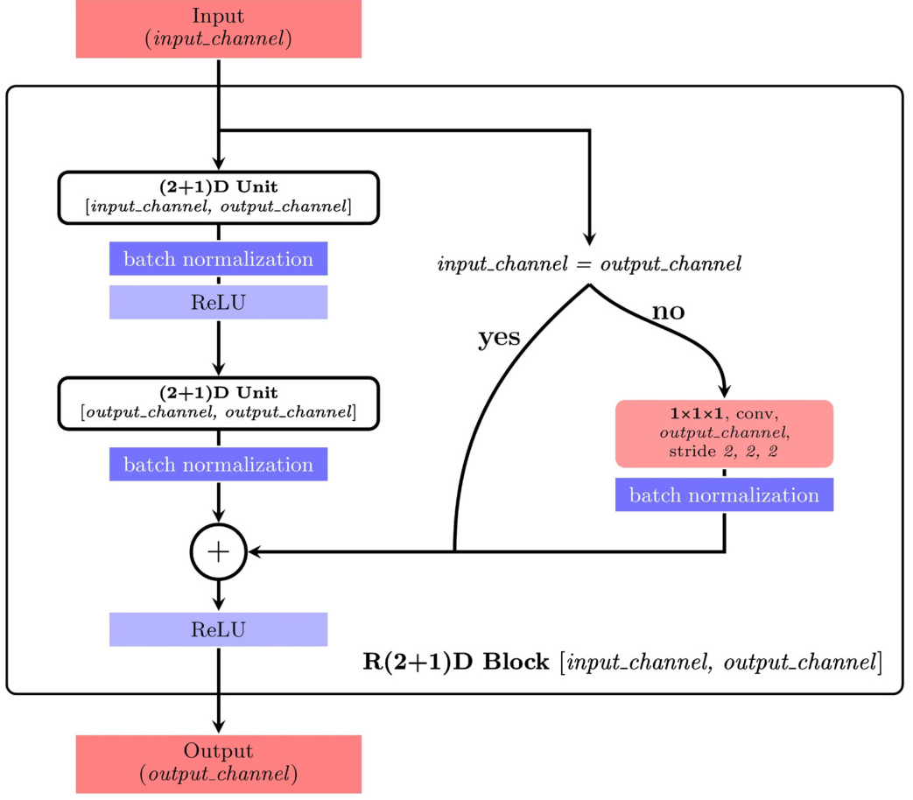
Video Action Recognition
R(2+1)D Basic Introduction
R (2+1) d is an innovative three-dimensional convolution decomposition method. By splitting the 3D convolution kernel into a combination of spatial 2D convolution and temporal 1D convolution, it solves the problems of large parameters and difficult optimization of traditional 3D CNN.
Nguyen, N. G., Phan, D., Lumbanraja, F. R., Faisal, M. R., Abapihi, B., Purnama, B., ... & Satou, K. (2019). Applying deep learning models to mouse behavior recognition. Journal of Biomedical Science and Engineering, 12(02), 183-196.
Notes:
R(2+1)D是一种创新的三维卷积分解方法，通过将3D卷积核拆分为空间2D卷积和时间1D卷积的组合，解决了传统3D CNN参数量大、优化困难的问题。

Slide 15
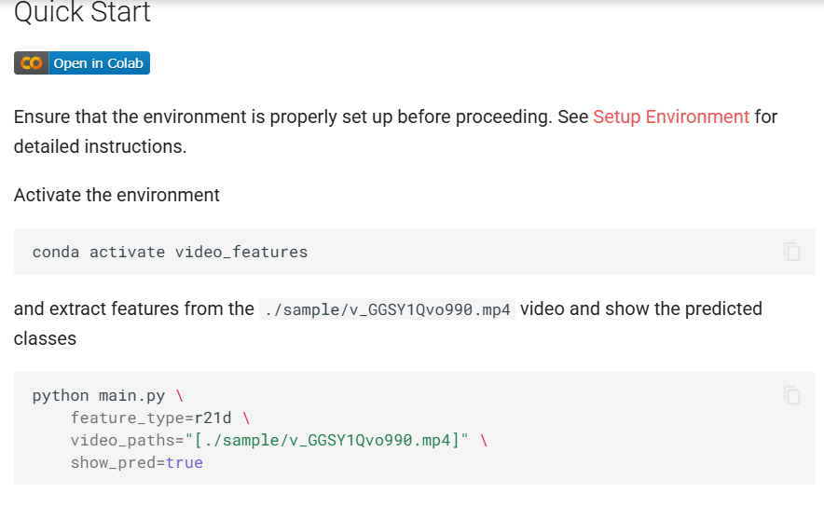
Video Action Recognition
Implementation of R (2+1) D thesis algorithm
Based on the open source GitHub project video features, we can call the neural network model in the following ways:
https://github.com/v-iashin/video_features/tree/master

Slide 16
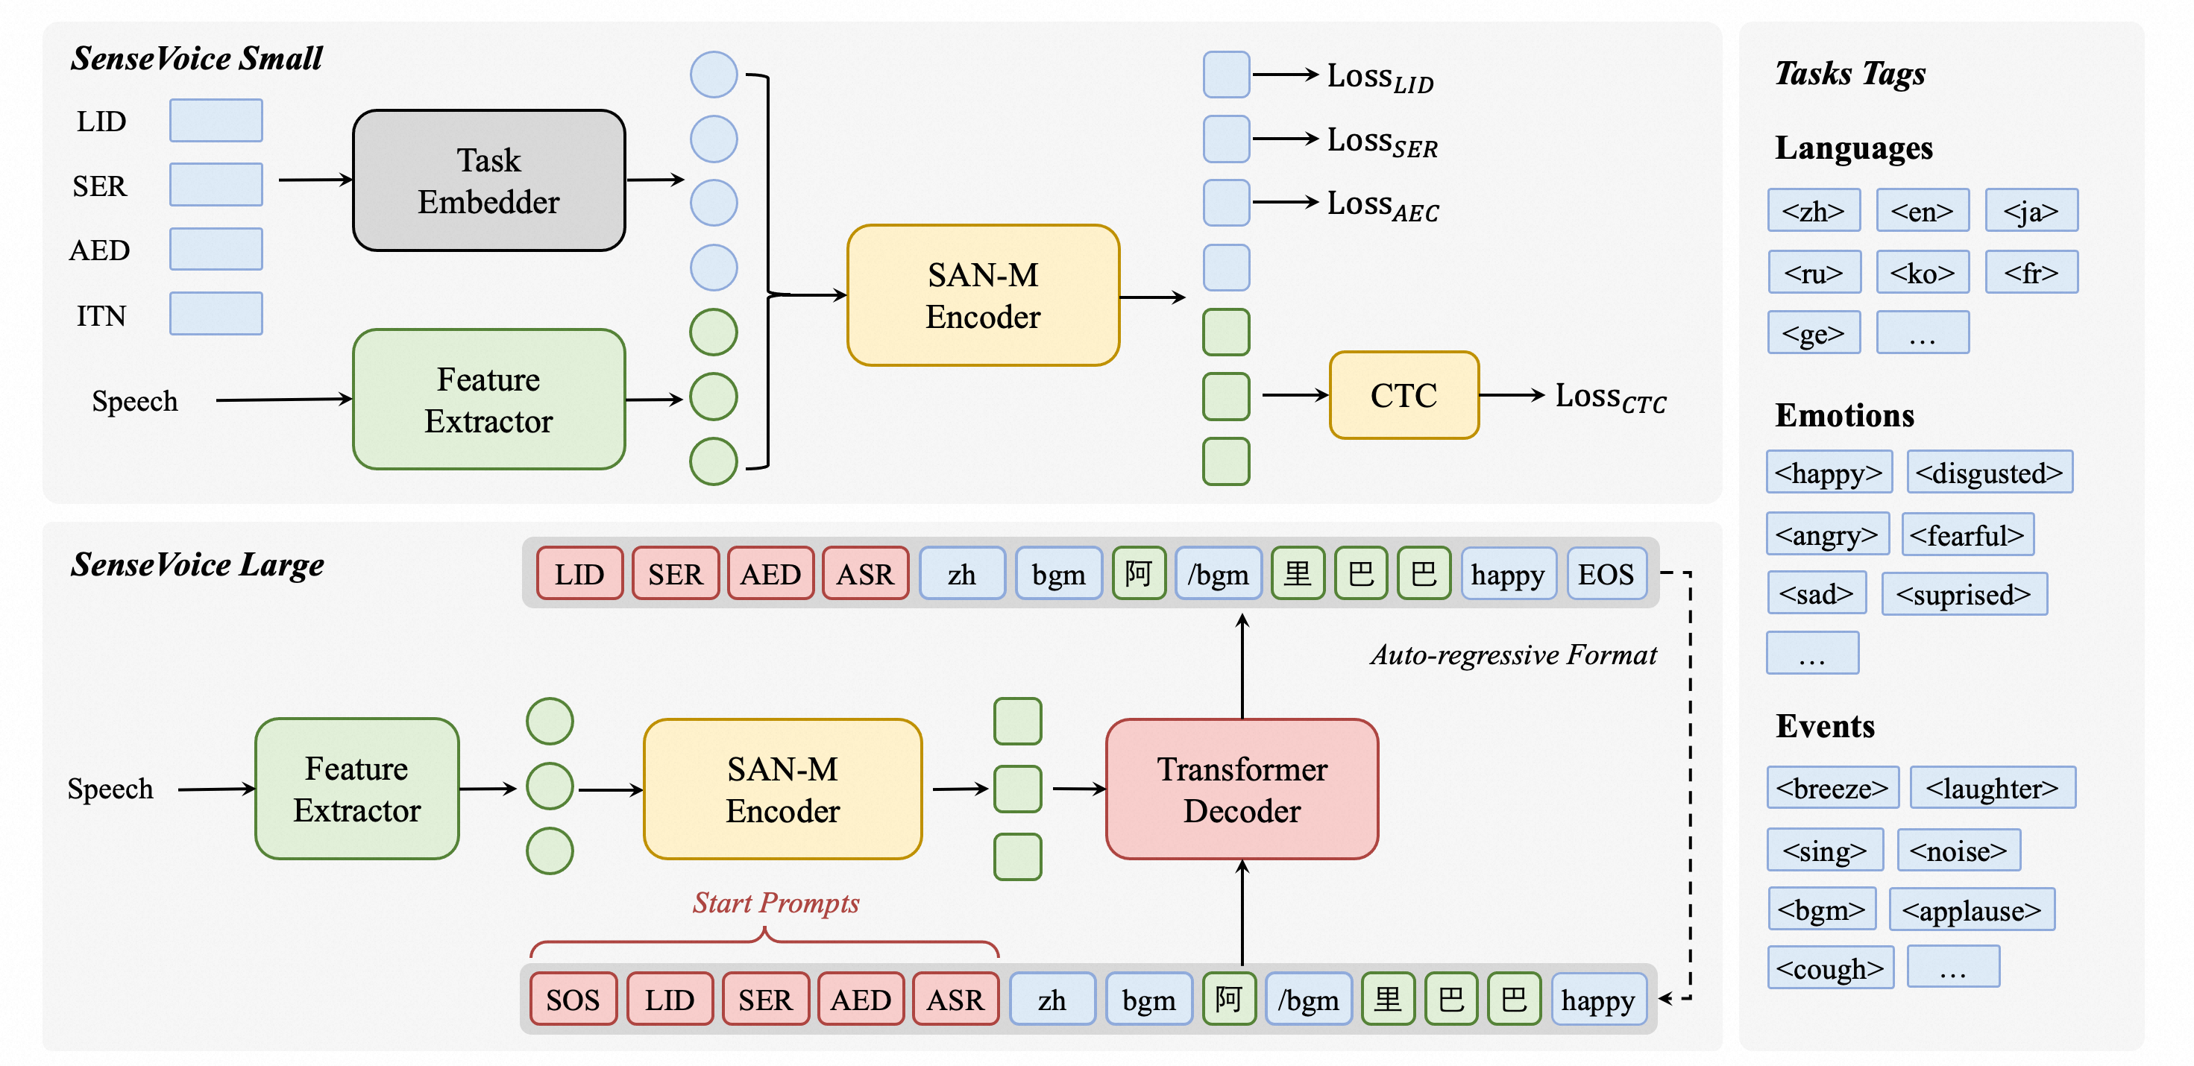
Audio Feature Extraction
SenseVoice Basic Introduction
SenseVoice is a speech foundation model with multiple speech understanding capabilities, including automatic speech recognition (ASR), spoken language identification (LID), speech emotion recognition (SER), and audio event detection (AED).
https://github.com/FunAudioLLM/SenseVoice
Notes:
SenseVoice基本介绍
SenseVoice是一个具有多种语音理解能力的语音基础模型，包括自动语音识别（ASR）、口语识别（LID）、语音情感识别（SER）和音频事件检测（AED）。

Slide 17
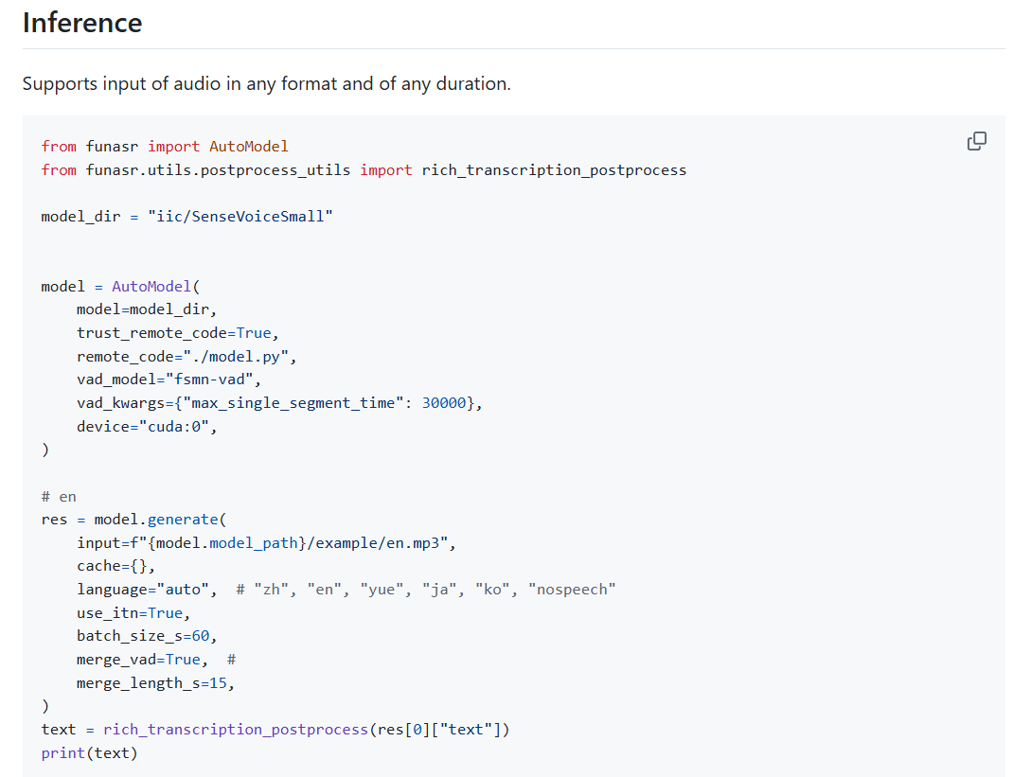
Audio Feature Extraction
SenseVoice Basic Use
Based on the open source GitHub project SenseVoice, we can call the project in the following ways:
https://github.com/FunAudioLLM/SenseVoice

Slide 18
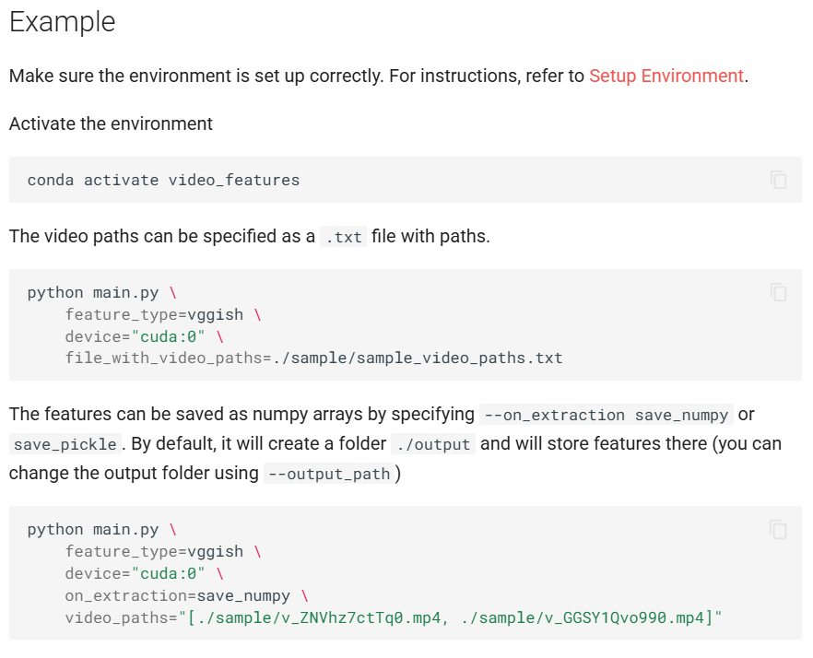
Audio Feature Extraction
Alternatives to sensevoice: VGGish
Vggish is a deep convolutional neural network (CNN) developed by Google team based on vggnet architecture, which is designed for audio feature extraction.
https://github.com/v-iashin/video_features/tree/master/models/vggish
Syed, Z. S., Memon, S. A., & Memon, A. L. (2020). Deep acoustic embeddings for identifying parkinsonian speech. International Journal of Advanced Computer Science and Applications, 11(10), 726-734.
Notes:
VGGish是由Google团队基于VGGNet架构开发的深度卷积神经网络（CNN）,专为音频特征提取设计。

Slide 19
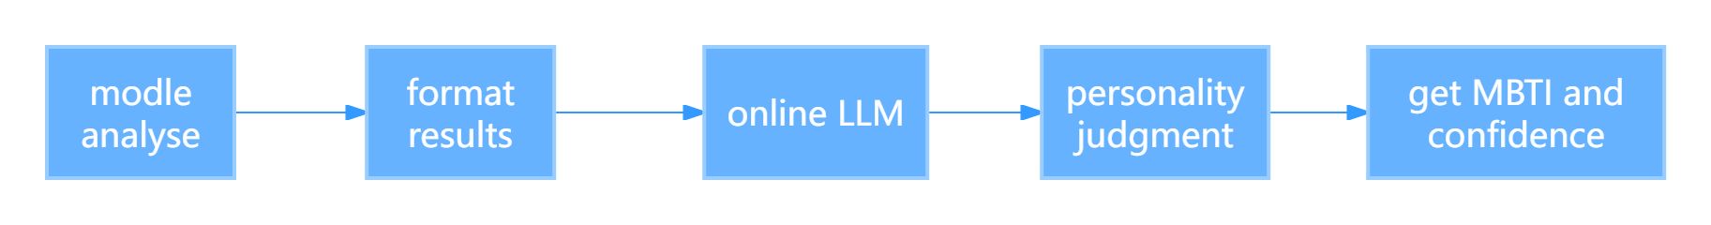
LLM infers personality
By calling the API of chatgpt 4O, we pass the formatted information of chat text with time stamp, voice events, voice emotion, behavior and action to chatgpt 4O model, and let it analyze and make MBTI character judgment, and give the reliability in the formatted string, and then we give MBTI character, confidence and complete AI analysis answer by string search.
Notes:
通过调用chatgpt 4o的api，我们将带时间戳的聊天文本以及语音事件，语音情感，行为动作的格式化信息传递给chatgpt 4o模型，让其分析做出MBTI性格判断，并且以格式化字符串给出确信度，然后我们通过字符串查找的方式给出MBTI性格以及确信度以及完整的ai分析回答。

Slide 20
Challenge
Compensation method for the lack of complementary features between modes in multimodal character recognition
In multimodal character recognition, there is such a problem that if the online large language model is used, it will be difficult to carry out multimodal analysis of an interview scene video, so we will carry out local analysis of the data of each mode, and upload the analysis results to the large language model. However, compared with the local multimodal large language visual model, this method will lack many complementary features between modes. How can we make up for the lack of this part as much as possible?
Notes:
在多模态性格识别中，使用在线大语言模型对面试场景视频进行分析时，存在难以整合多模态数据的问题。为了解决这一问题，我们选择将各个模态的数据进行本地分析，并将分析结果上传给大语言模型。然而，这种方法相较于本地的多模态大语言视觉模型，会缺失许多模态间互补的特征。我们如何尽可能地弥补这部分缺失？

Slide 21
Solution
Conduct fusion analysis when analyzing multimodal data locally to strengthen the local analysis ability.
Through the symmetrical cross modal attention module (MA), the interaction is enhanced while preserving the modal independent features in the local coding phase.
About link :https://link.springer.com/article/10.1007/s00371-022-02492-4
Cai, G., Zhu, Y., Wu, Y., Jiang, X., Ye, J., & Yang, D. (2023). A multimodal transformer to fuse images and metadata for skin disease classification. The Visual Computer, 39(7), 2781-2793.
Notes:
思路：在本地分析多模态数据时候进行融合分析，加强本地分析能力。 通过对称的跨模态注意力模块（MA），在本地编码阶段保留模态独立特征的同时增强交互。

Slide 22
Solution
Weight decision level fusion is a strategy widely :
Its core idea is to dynamically adjust the weight of each mode based on the prediction results of multiple modes (such as voice, vision and text), so as to achieve a better final decision. The advantage of this method is that it can flexibly allocate weights according to the reliability of modes and task requirements, so as to improve the robustness and accuracy of the overall system.
We decided to adopt the weight adjustment based on confidence. We added confidence to the results of each modal analysis, and added "pay more attention to the results with high confidence for personality analysis" to the system prompt of chatgpt 4o
Notes:
权重决策级融合核心思想是在多个模态（如语音、视觉和文本）的预测结果基础上，通过动态调整各模态的权重，以实现更优的最终决策。这种方法的优势在于能够根据模态的可信度和任务需求灵活分配权重，从而提高整体系统的鲁棒性和准确性。 基于置信度的权重调整：
决策级融合通常会根据各模态的置信度来调整权重。我们决定采用基于置信度的权重调整，我们将各个模态分析的结果添加上置信度，并且在chatgpt 4o的系统提示词上添加上“更加优先关注置信度高的结果进行性格分析”

Slide 23
Evaluate Solution
Qualitative Analysis
Advantage: By dynamically adjusting the weights of each modality based on confidence, the system can better handle situations where the reliability of different modalities varies.
Disadvantage:The performance of this method may be affected by the quality and quantity of data. If the data of a certain modality is of poor quality or insufficient quantity, it may affect the accuracy of its confidence calculation and the reliability of its analysis results, thereby affecting the overall performance of the system.
Notes:
通过基于置信度动态调整每个模态的权重，系统可以更好地处理不同模态可靠性不同的情况。 此方法的性能可能会受到数据质量和数量的影响。如果某一模态的数据质量较差或数量不足，可能会影响其置信度计算的准确性和分析结果的可靠性，从而影响系统的整体性能。

Slide 24

Thanks
LOGO

Slide 25
疑惑点
我们面临的挑战
解决方法
如何评价我们的方法

Slide 26
识别方法
Directly Feed the Video to a Multimodal AI: The AI, which has been trained to process and integrate various types of data (such as text, images, and audio), directly outputs the personality analysis results based on the video input. This enables a comprehensive assessment.
Separate Data Processing and Transformation: This method involves processing each modality of data separately. Text, images, and audio are converted into formatted text and then fed to a large language model for judgment. This allows for more granular control over data processing and analysis.
Aspect | Directly Using Multimodal AI | Data Conversion and Judgment
Efficiency | High | Moderate
Accuracy | Depends on the AI model | Can be high with proper processing
Interpretability | Low | High
Complexity | Low | High
Data Privacy | Potential concerns | Easier to manage
Notes:
1. 直接使用多模态AI：将视频传递给具有多模态能力的AI，直接获取性格分析结果。
2. 数据转换与判断：分别处理各个模态的数据，将其转换为格式化文本后，传递给大型语言模型进行判断。

Slide 27
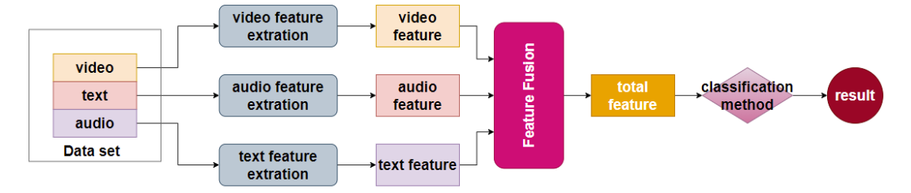
相关研究
1.Multimodal Big Language Modelling in Interview Scenarios:
Current systems capture video/audio/text via cameras/mics, using hybrid architectures (modular/end-to-end) with SSR-Net/SVM for feature extraction, fused via weighting/attention.
2.Specific technology：
Multimodal feature extraction：①Audio: Acoustic features (MFCCs, pitch, energy) modeled via CNN/LSTM for non-verbal cues (speech rate, intonation)；②Vision: Facial AUs/micro-expressions via OpenFace/VGG with keyframe clustering. ③Text: Lexical/semantic analysis via word2vec/SentiWordNet for emotional coherence.
Multimodal Fusion:①Decision-level: Weighted averaging (psychologically weighted);②Feature-level: Neural-based dynamic fusion (LSTM/attention);③End-to-end: CNNs/LSTMs with full backpropagation.
Contextual Modeling: LSTM/bi-LSTM temporal modeling for dynamic trait inference.
References
1. Investigating Audio, Visual, and Text Fusion Methods for End-to-End Automatic Personality Prediction(https://arxiv.org/abs/1805.00705) 2.Automated Screening of Job Candidate Based on Multimodal Video Processing(https://openaccess.thecvf.com/content_cvpr_2017_workshops/w26/html/Gorbova_Automated_Screening_of_CVPR_2017_paper.html)； 3.https://www.zhuanlichaxun.net/pdf/14187002.html
4.https://max.book118.com/html/2023/0603/5022033301010220.shtm
Notes:
多模态性格分析模型文献参考： 1. Investigating Audio, Visual, and Text Fusion Methods for End-to-End Automatic Personality Prediction(https://arxiv.org/abs/1805.00705) 多模态深度神经网络架构包含三个独立的通道，分别处理音频、文本和视频数据，这些通道在决策层和网络内部进行融合。整个架构采用端到端训练，能够自动从原始输入中学习特征。 研究了三种融合方法：
决策层融合：通过集成（投票）方法，找到每个模态和特质的线性组合权重。
有限反向传播：冻结各通道的所有层，仅学习通道输出的组合。
全反向传播：更新音频和文本通道的参数，使模型能够学习不同通道之间的复杂交互。 2.Automated Screening of Job Candidate Based on Multimodal Video Processing(https://openaccess.thecvf.com/content_cvpr_2017_workshops/w26/html/Gorbova_Automated_Screening_of_CVPR_2017_paper.html)； 一种基于多模态视频处理的求职者自动筛选系统。该系统旨在通过分析求职者的短视频片段，自动预测其大五人格特质分数，并决定是否邀请其参加面试。该系统通过从短视频片段中提取视觉、音频和词汇线索，使用深度学习分别训练每个模态的特征，然后将结果融合以预测最终得分。 多模态数据分析面试者性格文献参考： 3.基于多模态识别的人力资源面试系统(https://www.zhuanlichaxun.net/pdf/14187002.html) 4.一种基于多模态信息的面试测评方法和系统(https://max.book118.com/html/2023/0603/5022033301010220.shtm) 具体使用技术：
1.多模态特征提取
音频：使用MFCCs、基频、能量等声学特征，通过CNN或LSTM建模非语言线索（如语速、语调）。
视觉：通过OpenFace、VGG等模型提取面部动作单元（AUs）、微表情、姿态特征，结合关键帧聚类减少冗余。
文本：基于词嵌入（word2vec）或情感词典（SentiWordNet）分析词汇选择、情感极性及语义连贯性。 2.多模态融合策略
决策级融合：对单模态预测结果加权平均（如根据心理学权重分配）。
特征级融合：通过神经网络（LSTM、注意力机制）动态整合跨模态特征，捕捉复杂交互。
端到端模型：结合CNN和LSTM进行时序建模，支持全模态联合优化（如全反向传播训练）。 3.上下文建模
使用LSTM或双向LSTM捕捉视频中多语句的时序依赖，增强对动态性格特征的推理 综上所述。由现有技术得出改进重点在于： 1.平衡多模态间的差异（视觉和音频主导外向性等易观察特质，文本在跨语言场景（如翻译噪声）或文化差异下表现弱。） 2.平衡实时性与数据局限性（长视频时序建模（多帧动态分析资源消耗大，则依赖短时视频片段（如15秒）易忽略长期行为模式。）
3.Improvements available:
①Address modality gaps (text underperforms in cross-lingual/cultural contexts; visual/audio dominate observable traits).②Optimize resource use: lightweight architectures for multi-frame analysis, expand beyond short clips to model long-term behaviors.

Slide 28
这一页仅做提示，不要
数据如何采集
三个模态的特征如何提取
如何把提取后的三个模态的特征交由大语言模型来处理。
处理之后的结果是什么？

Slide 29
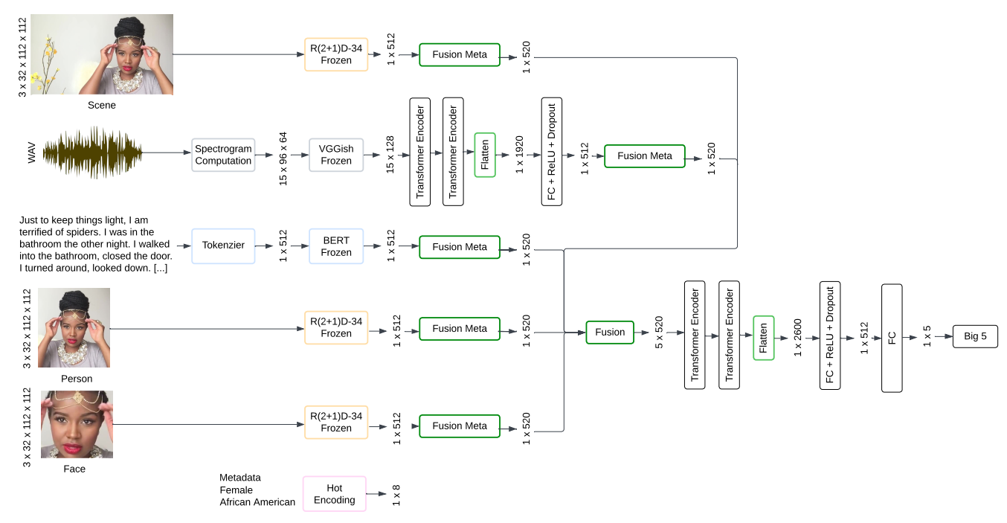
Video Processing
GitHub Project：PersonFormer - A Multimodal Video-based Personality Recognition System using Transformer
https://github.com/Jess3210/PersonFormer
Notes:
我们找到了一个github项目一个多模态神经网络判断人性格的神经网络，并且其提供了大量的练习数据，可惜因为该项目所依赖的python包过时的缘故不得不放弃。不过我们从中获取了一些灵感。

Slide 30
背景部分文献支持
以下是针对“现有方法”部分的文献引用链接，按照要求选择与面试和性格测试相关的文献：
1. **MBTI职业性格测试在面试中的应用**：该文献探讨了利用MBTI职业性格测试工具在招聘面试中的应用，分析了面试中常见的问题，如面试者动机不易判断、面试表现与实际工作表现不一致等，并提出通过MBTI测试来判断应聘者的价值观和基本行为模式。
[MBTI职业性格测试在面试中的应用 - 百度学术](https://xueshu.baidu.com/usercenter/paper/show?paperid=1g6g0c80kv7a04r0ju4a06x0ek486951)
2. **MBTI职业性格测试在面试中的应用**：该文献同样探讨了MBTI在面试中的应用，分析了面试中常见的问题，并提出利用MBTI测试来评估应聘者的价值观和行为模式，从而筛选合适的人选。
[MBTI职业性格测试在面试中的应用-期刊-万方数据知识服务平台](https://d.wanfangdata.com.cn/periodical/Ch9QZXJpb2RpY2FsQ0hJTmV3UzIwMjUwMTA0MTcwMjI2EhBxeWdneWdsMjAxOTExMDUyGgg5MXBscHU5cQ%3D%3D)
3. **青年职业发展与性格因素基于MBTI性格测试工具的初步探索**：该文献介绍了MBTI性格测试工具在职业发展中的应用，探讨了性格因素对青年职业发展的影响，并指出MBTI测试工具在职业咨询和生涯规划中的应用价值。
[青年职业发展与性格因素基于MBTI性格测试工具的初步探索 - 万方数据](https://d.wanfangdata.com.cn/thesis/ChhUaGVzaXNOZXdTMjAyNDA5MjAxNTE3MjUSCFkxOTY4MzM4GghvYjNhb3A0OA%3D%3D)
4. **MBTI人格类型量表：在国内外近十年的应用研究**：该文献综述了MBTI人格类型量表在不同领域的应用，包括科技、教育、管理等，指出MBTI在评估人格类型方面的应用广泛且深入，可以为面试和职业选择提供参考。
[MBTI人格类型量表：在国内外近十年的应用研究](https://pdf.hanspub.org/ASS20220500000_64612787.pdf)
这些文献提供了关于传统性格测试方法（如MBTI）在面试中的应用及其局限性，为后续提出改进方法提供了有力支持。

Slide 31
Dynamic Personality Recognition through Multimodal AI System
Advantages of Multimodal MBTI Testing
Multimodal MBTI testing integrates multiple data inputs such as text, images, and audio.
It provides a more comprehensive assessment by capturing rich contextual information and details.
This enhances the accuracy and reliability of the test results.
Notes:
使用面对面的交流方式，更能反映性格

Slide 32
Separate Data Processing and Transformation
方法概述
我们的性格检测系统创新性地融合了多模态感知与大语言模型（MLLM）技术，通过对面试者的语言表达、语音特征、面部表情及肢体动作进行全方位分析，构建多维度的性格评估模型。系统采用"视频解构-特征提取-多模态融合-性格画像"的四阶段分析流程，突破传统单一维度测评的局限，实现更精准的人格特质识别。
核心技术模块
视频智能解构
通过自研的流媒体处理引擎，实时分离视频中的音轨与画面（帧率自适应可达60fps），同步进行： ▶ 语音转文字（支持中英双语及方言识别） ▶ 声纹特征提取（基频、语速、停顿频率等12维参数） ▶ 关键帧捕捉（微表情识别精度达50ms级）

Slide 33
Separate Data Processing and Transformation
语言内容分析
基于千亿参数大语言模型，构建三维语义分析体系：
▶ 主题聚类：识别回答中的核心价值取向
▶ 情感映射：量化积极/消极词汇密度（NRC情感词典）
▶ 逻辑关联：通过话语连贯性评估认知复杂度
非语言行为建模-视觉特征引擎
▶ 微表情识别：基于FACS编码系统，捕捉28类基础表情单元
▶ 姿态分析：通过OpenPose架构建立17节点骨骼模型，量化手势幅度、身体朝向等动态特征
▶ 注视轨迹：瞳孔定位算法精确计算视觉关注区域

Slide 34
Separate Data Processing and Transformation
多模态决策融合
开发跨模态注意力机制，动态调节各维度权重：
语音韵律（音量波动、语调升降）与语义情感一致性校验
微表情瞬态变化（如抿嘴/挑眉）与语言内容的矛盾检测
肢体开放度（手臂伸展角度）与心理防御机制关联建模

Slide 35
Problem
Notes:
在面试场景中，仅依靠单一模态的数据（如文本、音频或视频）进行性格评估，无法全面捕捉求职者的性格特征。例如，仅通过文本分析可能忽略语音语调和面部表情等重要信息，而仅通过音频分析又可能遗漏文字表达和肢体动作的细节。因此，需要一种能够整合多种模态数据的性格评估方法，以提高评估的准确性和可靠性。 基于多模态输入准确判断人的性格，特别是通过视频输入判断面试者的 MBTI 性格类型。明确输入为视频，输出为 MBTI 性格类型。

